Slide 1


A Change in Momentum
Demonstrating the conservation of momentum.

Slide 2

A Change in Momentum
Demonstrating the conservation of momentum.
^{Objective}
The purpose of this activity is to investigate the conservation of momentum by means of a quantitative approach, create a hypothesis and proceed to test it using the Labdisc built-in distance (motion) sensor.

Slide 3

A Change in Momentum
Demonstrating the conservation of momentum
Introduction and theoretical background
The aim of the introduction is to focus students on the subject of the class by refreshing acquired knowledge and asking questions which encourage research development. Then, key concepts of the theoretical framework which will be used by the students during the class are taught.
In our everyday life, physical phenomena occur all the time. Undoubtedly, movement versus force are shown when you carry a backpack and run to school because you’re late. Equally when we see different sized objects in various shapes moving as a consequence of force application. A particular example of this physical connection can be observed when a rugby player collides with another player to stop his movement, or when two pool balls collide.

Slide 4

A Change in Momentum
Demonstrating the conservation of momentum
^{Introduction and theory}
What are the similarities between a car crash, a rugby match and a pool game?
How do does the displacement velocity vary when two bodies collide?
Carry out the experiment activity with your class so that at the end you’ll be able to answer the following question.
What does the amount of movement depend on?

Slide 5

A Change in Momentum
Demonstrating the conservation of momentum
^{Introduction and theory}
^{Theoretical}
Momentum or the amount of movement is a physical concept which describes the motions of an object relative to the displacement speed and mass. Like every vector, momentum has magnitude and direction. If we have a two-body system, supposing the frictional force is negligible, the global momentum (p) will be constant i.e. the amount of movement previous and after the collision will be equivalent. This physical principle is called the Conservation of Momentum.

Slide 6



A Change in Momentum
Demonstrating the conservation of momentum
^{Introduction and theory}
The collision between the bodies may be elastic or inelastic. This law can be expressed mathematically in the following equation:
$$\vec{p}= m\vec{v}$$
(eq.1)
Where,
p : momentum [kg m s⁻²]
m : mass of the body [kg]
v : velocity [m s]
Considering two bodies (A,B):
$$\vec{p_{A}}={m_{A}\vec{v}}_{A}$$
$$\vec{p_{B}}={m_{B}\vec{v}}_{B}$$

Slide 7


A Change in Momentum
Demonstrating the conservation of momentum
^{Introduction and theory}
We are going to take into account two kinds of collisions in two situations, before (i) and after (f):
$$\vec{p_{A}}+ \vec{p_{B}}={m_{A}\vec{v}}_{A}+ {m_{B}\vec{v}}_{B}$$
(eq.2)
If the collision is elastic
$${m_{A}\vec{v}}_{Ai}+ {m_{B}\vec{v}}_{Bi}={m_{A}\vec{v}}_{Af}+ {m_{B}\vec{v}}_{Bf}$$
(eq.3)

Slide 8



A Change in Momentum
Demonstrating the conservation of momentum
^{Introduction and theory}
If the collision is inelastic – meaning the two bodies continue moving together
$${m_{A}\vec{v}}_{Ai}+ {m_{B}\vec{v}}_{Bi}={m_{A}\vec{v}}_{Af}+ {m_{B}\vec{v}}_{Bf}$$
(eq.4)
(i.e. ${m_{B}\vec{v}}_{Bi}=0$)
But if the initial velocity of body B is zero and the final velocity is the same for both mobiles, then:
$${m_{A}\vec{v}}_{Ai}=(m_{A}+ {m_{B })\vec{ v}}_{ABf}$$
(eq.5)

Slide 9

A Change in Momentum
Demonstrating the conservation of momentum
^{Introduction and theory}
Now students are encouraged to raise a hypothesis which must be tested with an experiment.
What is the momentum between two identical mass mobiles in an inelastic collision?

Slide 10

^{A Change in Momentum}
Demonstrating the conservation of momentum
^{Activity description}
Students will study the conservation of momentum in an inelastic collision. The experiment includes a two-cart system. They will measure the distance range as a function, also after the collision. After that, they will use the GlobiLab software tools for data analysis.

Slide 11
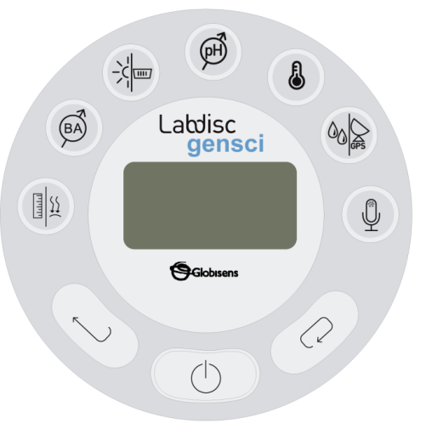
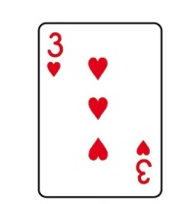

^{A Change in Momentum}
Demonstrating the conservation of momentum
^{Resources and materials}
1
Labdisc Gensci
2 identical carts (at least 1.5 g)
1 playing card
1 balance
A small piece of double-sided adhesive tape
2
1
3
4
5
2
3

Slide 12
^{A Change in Momentum}
Demonstrating the conservation of momentum
^{Using the Labdisc}
^{Labdisc configuration}
To collect measurements with the Labdisc and distance sensor, the Labdisc must be configured according to the following steps:
Open the GlobiLab software and turn on the Labdisc
Click on the Bluetooth icon in the bottom right corner of the GlobiLab. Select the Labdisc you are currently using. Once the Labdisc has been recognized by the software, the icon will change from a grey to blue color .
1
2

Slide 13

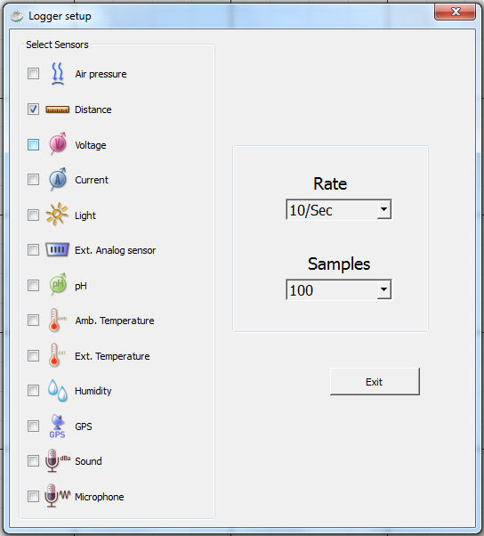
^{A Change in Momentum}
Demonstrating the conservation of momentum
^{Using the Labdisc}
3
Click on to configure the Labdisc. Select Distance in the “Logger Setup” window. Enter “10/sec” for the sample frequency and “100” for Samples.

Slide 14


^{A Change in Momentum}
Demonstrating the conservation of momentum
^{Using the Labdisc}
4
Once you have finished the sensor configuration start measuring by clicking
Once you have finished measuring stop the Labdisc by clicking
5

Slide 15
^{A Change in Momentum}
Demonstrating the conservation of momentum
^{Experiment}
1
Measure the mass of the carts.
Attach the double-sided adhesive tape to one cart and attach the card to the other cart.
Set a starting point and line up the carts 15 to 20 cm apart from each other. Place the cart with the card at the starting point.
Place the Labdisc at 40 cm from the starting point. The distance sensor must be in front of the cart.
2
3
4

Slide 16

^{A Change in Momentum}
Demonstrating the conservation of momentum
^{Experiment}
5
Start measuring with the Labdisc and push the cart with the card towards the other cart. The carts must remain together after the collision.
Stop measuring or just wait for the automatic stop.
6

Slide 17


^{A Change in Momentum}
Demonstrating the conservation of momentum
^{Results and analysis}
1
Pick up the first two inflection points on the curve with the markers .
Then, use the linear regression tool to discover the slopes of the curve between the first and second markers. The slopes quantify the which is the mean velocity.
Repeat steps 1 and 2, considering the second and third inflection point.
With the obtained data, calculate the initial and final momentum according to equation 5.
2
3
4

Slide 18

^{A Change in Momentum}
Demonstrating the conservation of momentum
^{Results and analysis}
What is the physical meaning of the slopes’ variation?
How do you relate the mathematical result to the real–life experiment?
Was the Conservation of Momentum principle fulfilled?
Was your hypothesis proven? Explain.

Slide 19
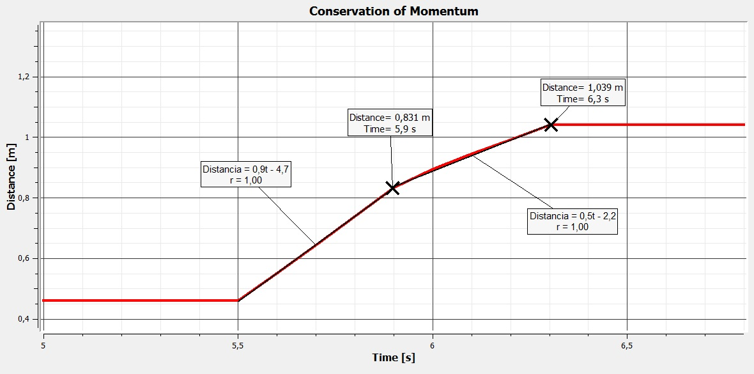
^{A Change in Momentum}
Demonstrating the conservation of momentum
^{Results and analysis}
The graph below should be similar to the one the students came up with:

Slide 20




^{A Change in Momentum}
Demonstrating the conservation of momentum
^{Conclusion}
Was the conservation of momentum proven with your data?
Students should consider the theoretical equation 5, because the initial velocity of the cart with the adhesive tape was 0 and both the carts’ mass was identical we should see the following equation:
Filling in the actual values of our experiment
Thereby, they can evaluate at both sides of the equation. In this case, we have a difference of 0.0007 between our results, representing a 4.4% error.
$${m_{A}\vec{v}}_{Ai}=(m_{A}+ {m_{B })\vec{ v}}_{ABf}$$
$$0.017 \left[Kg\right]∗ 0.9 \left[\frac{m}{s}\right]=0.032 \left[Kg\right]∗0.5\left[\frac{m}{s}\right]$$
$$0.0153 \left[Kg\frac{m}{s}\right]=0.0160\left[Kg\frac{m}{s}\right]$$

Slide 21

^{A Change in Momentum}
Demonstrating the conservation of momentum
^{Conclusion}
How can you explain the percentage difference? Why wasn’t the conservation of momentum accomplished?
The students can suggest that the supposed ideal conditions were not present. Namely, the two-carts system had to be isolated, which means that external forces did not impact on the experiment. Probably, the card and the physical structure of the carts were important factors in movement resistance.
What is the physical interpretation of the quantitative calculation?
Students should indicate that the momentum or amount of movement will be the same before, during and after the collision. Particularly, inelastic collision is an easy way to evaluate the conservation of momentum because of simplified conditions. However, a more complex system (i.e. elastic collision with two or more different mass carts) must be viewed with the same perspective.

Slide 22

^{A Change in Momentum}
Demonstrating the conservation of momentum
Activities for further application
A ball of 4 kg is moving at a speed of 10 m/s on a frictionless surface. It collides with a 3 kg ball moving in the same direction at 5 m/s. What is the final velocity of the system after the collision (consider the two balls together after the collision)?
Students should use the conservation of momentum law to find the solution, in particular equation (4):
4 [Kg] * 10 [m/s] + 3 [Kg] * 5 [m/s] = 7 [Kg] *V_{f}
Solving the equation, the final velocity of the system after the collision is 7.857 m/s.

Slide 23
^{A Change in Momentum}
Demonstrating the conservation of momentum
Activities for further application
You want to estimate the velocity of a 40 g golf ball after a golf club hit it. Looking at the player statistics, you find the ball was hit with a 0.5 kg golf club at 60 m/s. What was the velocity?
Students should consider that the ball initially is at rest (initial velocity = 0 ) and after the strike the club velocity will be 0. Then they should calculate the initial momentum (0.5 kg times
60 m/s). After obtaining this information, they can calculate the displacement speed of the ball, supposing there are not other forces acting on the ball (30 Kg*m*s⁻¹ / 0.04 kg = V_{ball}).

Slide 24


